Slide 1


Effects of sleepiness on resting-state connectivity
Isaac Perrin - Polytechnique Montréal

Slide 2

Background
Sleep deprivation is commonplace in society
Sleepiness has effects on cognitive and affective functioning:
Associations with amygdala-prefrontal functional connectivity
Inhibition of top-down-control in emotion
Further analysis on functional connectivity
Notes:
Image link: http://en.wikipedia.org/wiki/File:Chronic_fatigue_syndrome.JPG

Slide 3

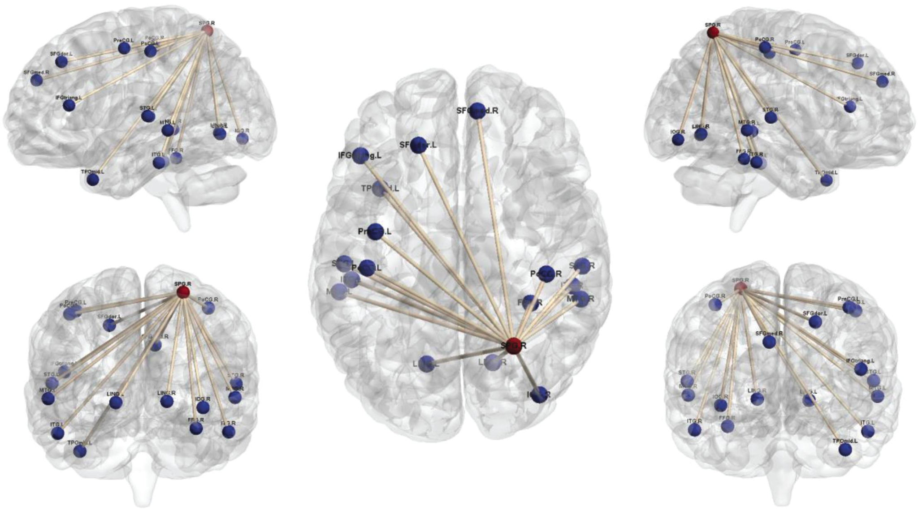
Main Question
Can resting-state functional connectivity predict sleep deprivation?
?
Notes:
Rs-fmri connectivity: https://www.frontiersin.org/articles/10.3389/fnins.2021.704079/full
Sleep deprivation: http://edelweisspublications.com/keyword/22/1352/Sleep-deprivation

Slide 4

Data:
What? Resting state fMRI from the Stockholm Sleepy Brain Study: Effects of Sleep Deprivation on Cognitive and Emotional Processing in Young and Old.
Why? Investigation on the effects of partial sleep deprivation (PSD) on resting state brain connectivity.
Where? OpenNeuro
Notes:
OpenNeuro logo: https://github.com/OpenNeuroOrg/openneuro

Slide 5






Tools & Methods
Git and GitHub for project management
DataLad for retrieval and version control of data
BIDS-validator to check updated dataset integrity
FMRIPrep for data preprocessing
Python (visualization, machine learning, …)
Notes:
GitHub logo: https://lthub.ubc.ca/guides/github-instructor-guide/
Git logo: https://abouthydrology.blogspot.com/2020/10/use-git-and-github.html
DataLad logo: https://www.psychoinformatics.de/software.html
BIDS logo: https://en.wikipedia.org/wiki/Brain_Imaging_Data_Structure
fMRIPrep logo: http://reproducibility.stanford.edu/resources/
Python logo: https://communityblog.fedoraproject.org/help-port-python-packages-to-python-3/

Slide 6
Objectives
Familiarize myself with neuroimaging data organization and open science practices
Learn reproductible neuroimaging workflow from preprocessing to data visualization
Visualize and compare functional connectomes of resting-state networks
Prospect: Build a machine learning model

Slide 7
Deliverables
GitHub repository containing all the elements of the project
Markdown file for the project description
Bash code for fMRI preprocessing
Requirements file to specify the Python environment
Jupyter notebook for visualization (and machine learning)

Slide 8
References
Killgore WD. Effects of sleep deprivation on cognition. Prog Brain Res. 2010;185:105-29. doi: 10.1016/B978-0-444-53702-7.00007-5. PMID: 21075236.
Reidy BL, Hamann S, Inman C, Johnson KC, Brennan PA. Decreased sleep duration is associated with increased fMRI responses to emotional faces in children. Neuropsychologia. 2016 Apr;84:54-62. doi: 10.1016/j.neuropsychologia.2016.01.028. Epub 2016 Jan 25. PMID: 26821063.
Gustav Nilsonne and Sandra Tamm and Paolo d’Onofrio and Hanna Å Thuné and Johanna Schwarz and Catharina Lavebratt and Jia Jia Liu and Kristoffer NT Månsson and Tina Sundelin and John Axelsson and Peter Fransson and Göran Kecklund and Håkan Fischer and Mats Lekander and Torbjörn Åkerstedt (2020). The Stockholm Sleepy Brain Study: Effects of Sleep Deprivation on Cognitive and Emotional Processing in Young and Old. OpenNeuro. [Dataset] doi: 10.18112/openneuro.ds000201.v1.0.3
Tamm S, Schwarz J, Thuné H, Kecklund G, Petrovic P, Åkerstedt T, Fischer H, Lekander M, Nilsonne G. A combined fMRI and EMG study of emotional contagion following partial sleep deprivation in young and older humans. Sci Rep. 2020 Oct 21;10(1):17944. doi: 10.1038/s41598-020-74489-9. PMID: 33087746; PMCID: PMC7578048.

